Slide 1
JFX

Slide 2
JavaFX
JavaFX applications can use Java API libraries to access native system capabilities and connect to server-based middleware applications.
With JavaFX, you can build many types of applications.
The applications as Network-aware that are deployed across multiple platforms and display information in a high-performance modern user interface that features audio, video, graphics, and animation.

Slide 3
Features of JFX
Java APIs. JavaFX is a Java library that consists of classes and interfaces that are written in Java code.
FXML. FXML is an XML-based declarative markup language for constructing a JavaFX application user interface.
Scene Builder application in IDE’s such as Eclipse and NetBeans, the users can access a drag and drop design interface,
WebView. A web component that uses WebKitHTML technology to make it possible to embed web pages within a JavaFX application.
Swing interoperability. Existing Swing applications can be updated with JavaFX features, such as rich graphics media playback and embedded Web content

Slide 4
Features of JFX
Built-in UI controls and CSS. JavaFX provides all the major UI controls that are required to develop a full-featured application. Components can be skinned with standard Web technologies such as CSS
3D Graphics Features.
Canvas API and Printing API.
Rich set of API’s − JavaFX library provides a rich set of API’s to develop GUI applications, 2D and 3D graphics, etc.
Rich Text Support. JavaFX 8 brings enhanced text support to JavaFX, including bi-directional text and complex text scripts

Slide 5
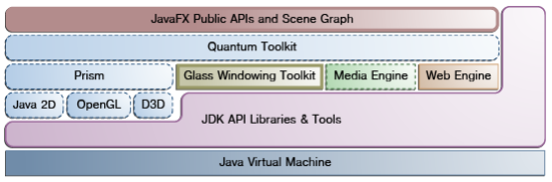
JFX Architecture

Slide 6
JFX Architecture
Scene Graph - A single element in a scene graph is called a node
Java Public APIs for JavaFX Features - Allow the use of powerful Java features, such as generics, annotations, multithreading
Graphics System - It supports both 2-D and 3-D scene graphs.
Glass Windowing Toolkit - main responsibility is to provide native operating services, such as managing the windows, timers, and surfaces
Media and Images
Web Component
CSS - JavaFX Cascading Style Sheets (CSS) provides the ability to apply customized styling to the user interface of a JavaFX application
UI Controls - check box, button, listbox, progress
Layout – Borderpane, Hbox, Vbox, Gridpane, Stackpane

Slide 7
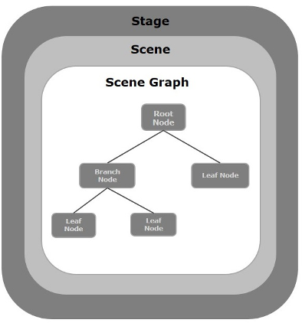
JavaFX Application Structure

Slide 8
JavaFX Application Structure
Stage - A stage (a window) contains all the objects of a JavaFX application. It is represented by Stage class of the package javafx.stage. The created stage object is passed as an argument to the start() method of the Application class.
Scene- Scene represents the physical contents of a JavaFX application. It contains all the contents of a scene graph.
A node may include −
Geometrical (Graphical) objects (2D and 3D) such as − Circle, Rectangle, Polygon, etc.
UI Controls such as − Button, Checkbox, Choice Box, Text Area, etc.
Containers (Layout Panes) such as Border Pane, Grid Pane, Flow Pane, etc.
Media elements such as Audio, Video and Image Objects.

Slide 9
JavaFX Application
The Application class of the package javafx.application is the entry point of the application in JavaFX.
To create a JavaFX application, you need to inherit this class and implement its abstract method start(). In this method, you need to write the entire code for the JavaFX graphics.
public class JavafxSample extends Application {
public void start(Stage primaryStage) throws Exception {
/*
Code for JavaFX application.
(Stage, scene, scene graph)
*/
}
public static void main(String args[]){
launch(args);
}
}

Slide 10
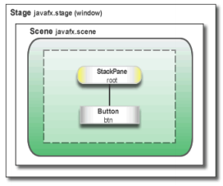
Hello world
Refer JFX Helloworld.pdf

Slide 11
Hello world
The main class for a JavaFX application extends the javafx.application.Application class. The start() method is the main entry point for all JavaFX applications.
A JavaFX application defines the user interface container by means of a stage and a scene.
The JavaFX Stage class is the top-level JavaFX container. The JavaFX Scene class is the container for all content. Here we create the stage and scene and makes the scene visible in a given pixel size.
In JavaFX, the content of the scene is represented as a hierarchical scene graph of nodes. In this example, the root node is a StackPane object, which is a resizable layout node. This means that the root node's size tracks the scene's size and changes when the stage is resized by a user.
The root node contains one child node, a button control with text, plus an event handler to print a message when the button is pressed.

Slide 12
Life cycle
An instance of the application class is created.
Init() method is called.
The start() method is called.
The launcher waits for the application to finish and calls the stop() method.

Slide 13
Creating a Form in JavaFX
Creating a form is a common activity when developing an application
1. From the File menu, choose New Project.
2. In the JavaFX application category, choose JavaFX Application. Click Next.
3. Name the project Login and click Finish.
4. Remove the start() method that NetBeans IDE generated and replace it with the code in
public void start(Stage primaryStage) {
primaryStage.setTitle("JavaFX Welcome");
primaryStage.show();
}

Slide 14
form
Create a GridPane Layout.
Add the code before the line primaryStage.show();
//Creating a Grid Pane
GridPane gridPane = new GridPane();
//Setting size for the pane
gridPane.setMinSize(400, 200);
//Setting the padding
// gridPane.setPadding(new Insets(10, 10, 10, 10));
//Setting the vertical and horizontal gaps between the columns
gridPane.setVgap(5);
gridPane.setHgap(5);
//Setting the Grid alignment
gridPane.setAlignment(Pos.CENTER);
//Arranging all the nodes in the grid
gridPane.add(text1, 0, 0);

Slide 15
Add Text, Labels, and Text Fields
//creating label email
Text text1 = new Text("Email");
//creating label password
Text text2 = new Text("Password");
//Creating Text Filed for email
TextField textField1 = new TextField();
//Creating Text Filed for password
PasswordField textField2 = new PasswordField();
//Creating Buttons
Button button1 = new Button("Submit");
Button button2 = new Button("Clear");

Slide 16
Arranging all the nodes in the grid
Ensure that you have added this : import javafx.scene.control.TextField;
//Arranging all the nodes in the grid
gridPane.add(text1, 0, 0);
gridPane.add(textField1, 1, 0);
gridPane.add(text2, 0, 1);
gridPane.add(textField2, 1, 1);
gridPane.add(button1, 0, 2);
gridPane.add(button2, 1, 2);

Slide 17
Final setup of stage
Scene scene = new Scene(gridPane);
//Setting title to the Stage
stage.setTitle("CSS Example");
//Adding scene to the stage
stage.setScene(scene);
//Displaying the contents of the stage
stage.show();
}
public static void main(String args[]){
launch(args);
}

Slide 18
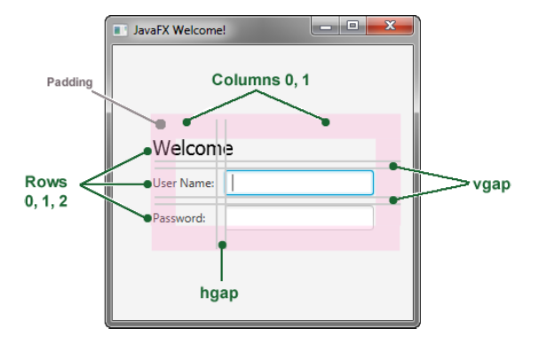
Login form

Slide 19
Add a Button
Button btn = new Button("Sign in");
HBox hbBtn = new HBox(10);
hbBtn.setAlignment(Pos.BOTTOM_RIGHT);
hbBtn.getChildren().add(btn);
grid.add(hbBtn, 1, 4);
The first line creates a button named btn with the label Sign in, and the second line creates an HBox layout pane named hbBtn with spacing of 10 pixels.
The HBox pane sets an alignment for the button that is different from the alignment applied to the other controls in the grid pane.
The alignment property has a value of Pos.BOTTOM_RIGHT, which positions a node at the bottom of the space vertically and at the right edge of the space horizontally.
The button is added as a child of the HBox pane, and the HBox
pane is added to the grid in column 1, row 4.

Slide 20
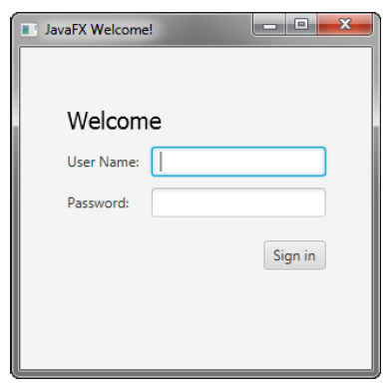
Login form

Slide 21
Add text
Add a Text control for displaying the message,
final Text actiontarget = new Text();
grid.add(actiontarget, 1, 6);

Slide 22
Add Code to Handle an Event
Ensure that you have added this import : import javafx.event.ActionEvent;
btn.setOnAction(new EventHandler<ActionEvent>() {
public void handle(ActionEvent e) {
actiontarget.setFill(Color.FIREBRICK);
actiontarget.setText("Sign in button pressed");
}
});
The setOnAction() method is used to register an event handler that sets the
actiontarget object to Sign in button pressed when the user presses the button.
The color of the actiontarget object is set to firebrick red.

Slide 23
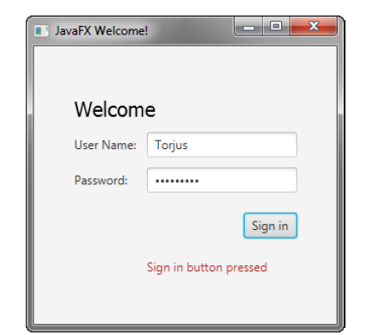
Final Login

